Slide 1
How Close Are Today’s AI Models to AGI—And to Self-Improving into Superintelligence?
Week of February 9th
Elias Hord

Slide 2
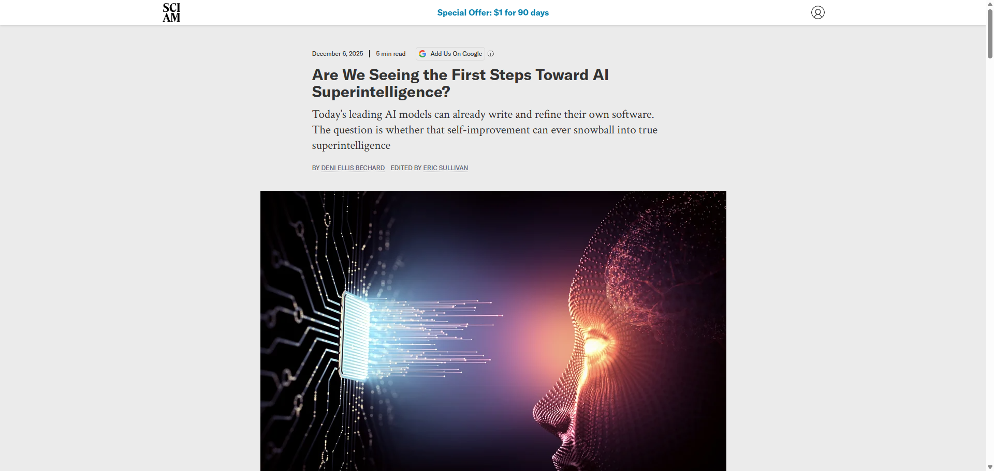
General Information
Article Publication: December 6, 2025
https://www.scientificamerican.com/article/how-close-are-todays-ai-models-to-agi-and-to-self-improving-into/

Slide 3
Main Findings and Arguments
AI Progress Toward Self-Improvement: Current advanced AI models can already write and refine software to a limited extent—e.g., systems like OpenAI’s Codex and Anthropic’s Claude Code can independently generate or modify code for a period of time. However, this self-improvement is narrow and still guided by humans rather than fully autonomous.
Human Involvement Remains Crucial: Despite impressive capabilities, AI still depends on humans to set goals, design experiments, and evaluate progress. This means existing systems do not genuinely evolve on their own in an open-ended way.
Depth vs. Breadth of Intelligence: While AI can process and manipulate vast amounts of information and sometimes outperform humans in specific tasks (like synthesizing large texts or discovering efficient algorithms), it lacks the kind of flexible reasoning across domains that characterizes human intelligence.
AGI and “Intelligence Explosion”: The article revisits the idea of an “ultraintelligent machine” from Irving John Good—that an AI capable of self-improvement could rapidly escalate into superintelligence. But current systems are not at that tipping point because they can’t self-direct their own evolution.
Divergent Expert Views: Some researchers think AGI might arrive within a few years, while others argue that major scientific breakthroughs are still needed to truly understand intelligence and build systems with broad, human-like adaptability.

Slide 4
Broader Implications for Society
Reality Check on Science Fiction: The article argues that popular narratives about imminent superintelligence (e.g., “The Matrix”), though attention-grabbing, overstate how close we are to systems that rival or surpass human cognitive abilities.
Human Roles in the Loop: Since current AI cannot autonomously set goals or measure its own progress, humans remain central to steering AI development. This has implications for how industries, regulators, and the public view responsibility and control over powerful AI technologies.
Safety and Governance: Because completely self-improving AI could theoretically trigger rapid, unpredictable advancements, AI safety testing and frameworks to monitor progress matter more than ever, especially as capabilities grow.
Polarized Predictions and Public Perception: The debate over how soon AGI might arrive—ranging from a few years to much longer—can shape public expectations, influence investment, and drive policy discussions about ethical oversight and regulation.

Slide 5
Relevance or Potential Influence on the Construction Industry
Enhanced Design and Planning Tools: Current AI’s ability to synthesize and analyze massive datasets could improve workflows such as planning, modeling, and code compliance checks. For example, uploading complex architectural plans and having AI generate critiques or options could save substantial time.
Code Generation and Automation: Tools that can autonomously write or improve software might translate into automation of scheduling, resource allocation, and logistics software—key components in modern construction project management.
Human-AI Collaboration: Since the article stresses that AI still needs humans to guide and assess progress, the future of AI in construction likely involves collaboration—where engineers and project managers leverage AI insights while providing judgment and oversight.
Long-Term Outlook on Autonomous Agents: If AI eventually reaches broader reasoning and self-improvement abilities (AGI), construction could see much deeper automation—potentially AI agents managing entire projects, optimizing processes, or integrating robotics in physical tasks. Right now, though, that level remains theoretical.

